Slide 1

Connected Samurais Continuous Integration and Delivery

Slide 2
AGENDA
Continuous Delivery
Resources
DevOps Overview
Next Steps
Continuous Integration

Slide 3

About Mark Saum
CIO and CISO of several technology startups
Deep experience in technology startups
Enterprise IT architecture consultant with over 20 years experience
Enterprise customers include JPMorganChase, General Motors, AT&T, Lucent Technologies, Verizon, US Cellular, FedEx and Raytheon
Currently a Principal DevOps Architect with BeyondSoft

Slide 4

DevOps Overview
Notes:
What Is DevOps?
https://theagileadmin.com/what-is-devops/
lynda.com/LinkedIn Learning (Free for Plano Library Card Holders)
DevOps Foundations (James, Ernest) – a three hour set of videos designed to orient beginners into the whole scope of DevOps.
https://www.lynda.com/Operating-Systems-tutorials/DevOps-Fundamentals/508618-2.html
DevOps Foundations: Infrastructure Automation (James, Ernest) – two hours of infrastructure automation concepts, with demos illustrating them in everything from Cloudformation to chef.
https://www.lynda.com/IT-Infrastructure-tutorials/DevOps-Foundations-Infrastructure-Automation/574705-2.html
DevOps Foundations: Continuous Delivery (James, Ernest) – what you need to know about continuous integration and delivery, with demos in jenkins, nexus, and more.
https://www.lynda.com/IT-Infrastructure-tutorials/DevOps-Foundations-Continuous-DeliveryContinuous-Integration/606079-2.html

Slide 5
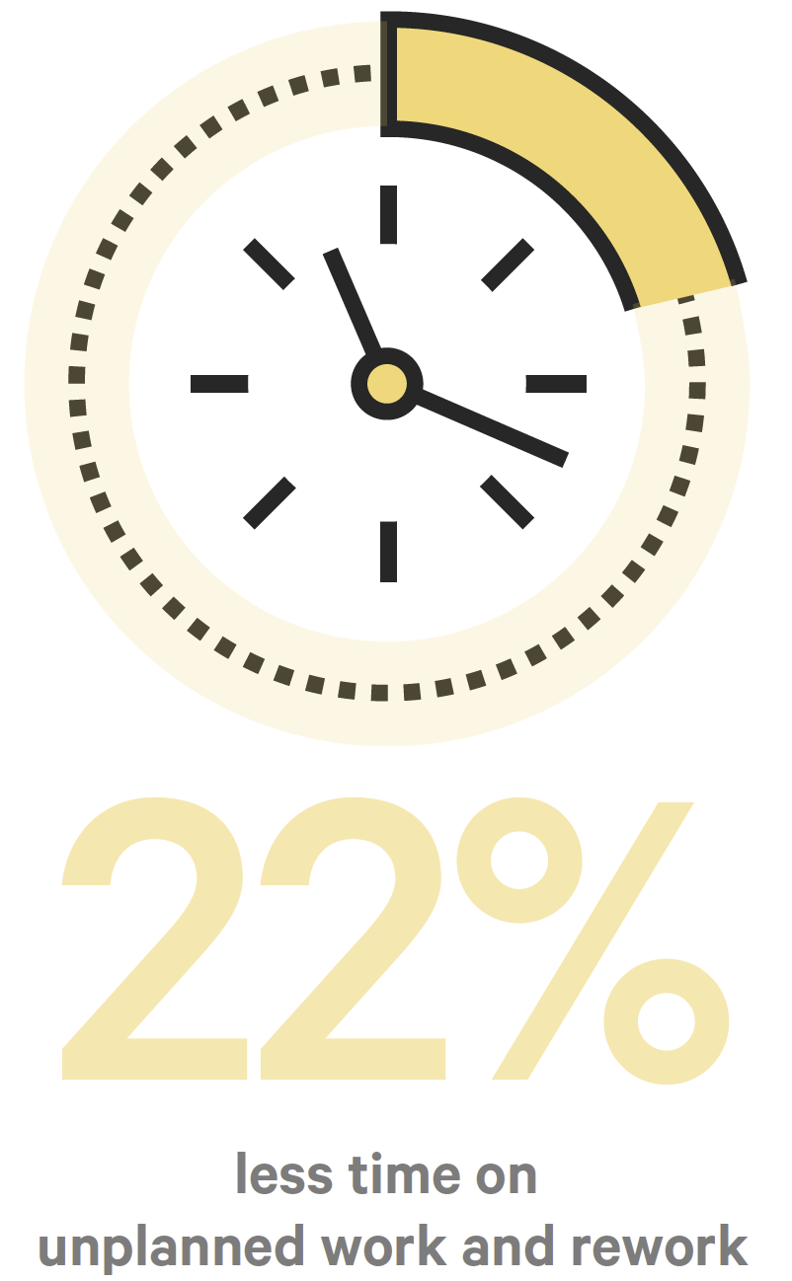
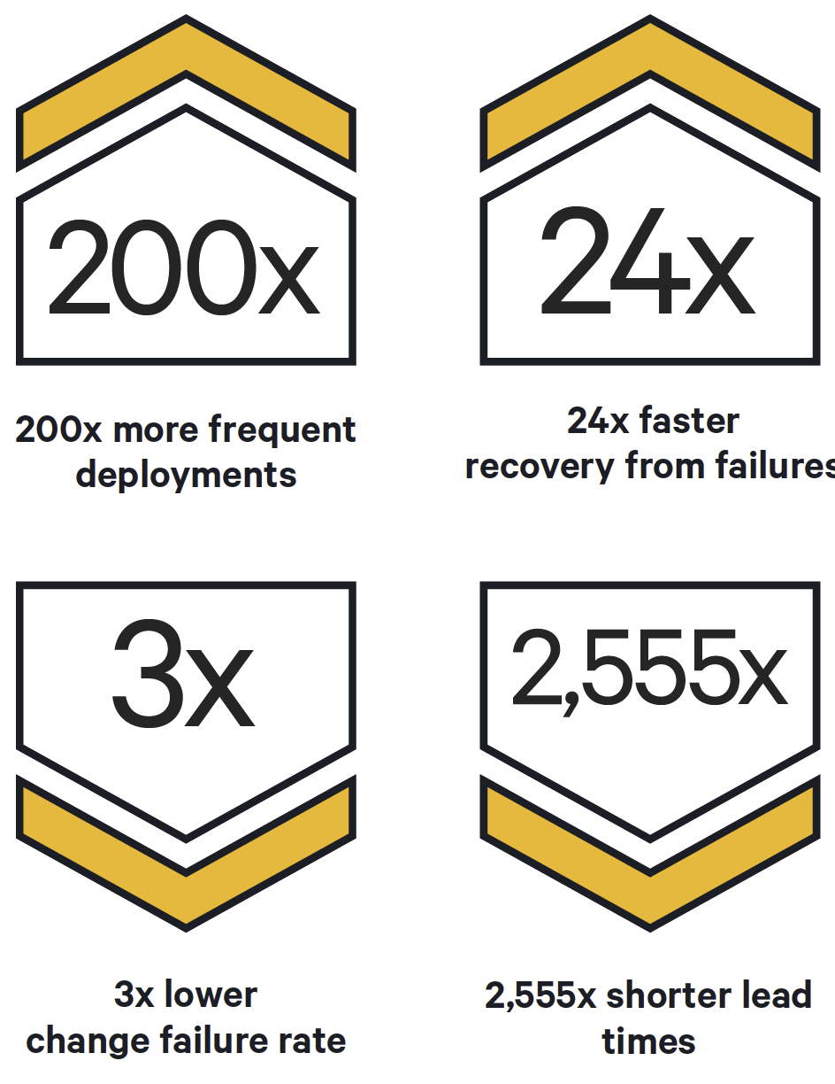
Why Should We Adopt DevOps?
Notes:
What DevOps Means To Me
John Willis
https://www.chef.io/blog/2010/07/16/what-devops-means-to-me/
DevOps Culture
John Willis
http://itrevolution.com/devops-culture-part-1/
People over Process over Tools
Damon Edwards
http://dev2ops.org/2010/02/people-over-process-over-tools/

Slide 6
What is DevOps
Culture first
A generative culture is critical
High-trust cultural norms allow collaboration
Work across organizational silos to enable strategic alignment
Technology second as a cultural and business process enabler
Implementing technologies and processes that enable developer productivity
Reducing code deployment lead times
Supporting more reliable infrastructures

Slide 7
CAMS
Sharing
Measurement
Automation
Culture
Notes:
What DevOps Means To Me
John Willis
https://www.chef.io/blog/2010/07/16/what-devops-means-to-me/
DevOps Culture
John Willis
http://itrevolution.com/devops-culture-part-1/
People over Process over Tools
Damon Edwards
http://dev2ops.org/2010/02/people-over-process-over-tools/
CAMS
http://devopsdictionary.com/wiki/CAMS
2015 State of DevOps Report
https://puppet.com/resources/white-paper/2015-state-devops-report
2016 State of DevOps Report
https://puppet.com/resources/white-paper/2016-state-devops-report
2017 State of DevOps Report
https://puppet.com/resources/whitepaper/state-of-devops-report

Slide 8
Culture
DevOps is learning how to work differently
DevOps embraces cross-functional teams with openness, transparency, and respect
Westrum Organizational Cultures:
Pathological (power-oriented)
Low cooperation across groups
Culture of blame
Information is withheld for personal gain
Bureaucratic (rule-oriented)
Preoccupied with rules and positions, and responsibilities
Compartmentalized by the department
Little concern for the overall mission of the organization
Generative (performance-oriented)
Good information flow
High cooperation and trust
Bridging between teams
Conscious inquiry
Source: A typology of organisational cultures, Westrum 2004
Notes:
Sources:
A typology of organisational cultures
https://www.ncbi.nlm.nih.gov/pmc/articles/PMC1765804/
How to Implement DevOps: The CAMS Approach
https://shadow-soft.com/how-to-implement-devops/

Slide 9
Automation
Computers should do what computers are best at
Automation is just a tool
Automation creates repeatable processes
Automation is necessary as it facilitates fast feedback
“If the build, deploy, test and release process is not automated, it’s not repeatable.” “When steps are taken manually, they are error prone, and there is no way to review exactly what was done.” – Jez Humble and David Farley, Continuous Delivery
Notes:
Sources:
How to Implement DevOps: The CAMS Approach
https://shadow-soft.com/how-to-implement-devops/

Slide 10
Measurement
Measurement allows us visibility to our performance
Errors are expected and provide learning opportunities
DevOps is a culture of constant improvement
Measurement allows us to identify waste
Measurement allows teams to align incentives
Notes:
Sources:
How to Implement DevOps: The CAMS Approach
https://shadow-soft.com/how-to-implement-devops/

Slide 11
Sharing
Sharing requires a blame-free environment
Focus on identifying the problem rather than placing blame
A blameless culture is a culture of sharing
Generative organizations have good information flow
Generative organizations demonstrate high cooperation and trust
Sharing allows us to communicate, cooperate and learn from each other
Notes:
Sources:
How to Implement DevOps: The CAMS Approach
https://shadow-soft.com/how-to-implement-devops/

Slide 12
Three Ways of DevOps
Systems Thinking
Amplifying Feedback Loops
Culture of Continuous Experimentation and Learning
Notes:
The Three Ways
Gene Kim
http://itrevolution.com/the-three-ways-principles-underpinning-devops/

Slide 13
The First Way: Systems Thinking
Focus on the performance of the entire system, as opposed to the performance of a specific silo of work or department
The focus is on all business value streams that are enabled by IT
The outcomes of putting the First Way into practice include never passing a known defect to downstream work centers, never allowing local optimization to create global degradation, always seeking to increase flow, and always seeking to achieve profound understanding of the system (as per Deming)
Notes:
The Three Ways
Gene Kim
http://itrevolution.com/the-three-ways-principles-underpinning-devops/

Slide 14
The Second Way: Amplifying Feedback Loops
Creating the right to left feedback loops
The goal of almost any process improvement initiative is to shorten and amplify feedback loops so necessary corrections can be continually made
The outcomes of the Second Way include understanding and responding to all customers, internal and external, shortening and amplifying all feedback loops, and embedding knowledge where we need it
Notes:
The Three Ways
Gene Kim
http://itrevolution.com/the-three-ways-principles-underpinning-devops/

Slide 15
The Third Way: Culture of Continuous Experimentation and Learning
Creating a culture that fosters two things: continual experimentation, taking risks and learning from failure; and understanding that repetition and practice is the prerequisite to mastery
Experimentation and taking risks are what ensures that we keep pushing to improve
The outcomes of the Third Way include allocating time for the improvement of daily work, creating rituals that reward the team for taking risks, and introducing faults into the system to increase resilience
Notes:
The Three Ways
Gene Kim
http://itrevolution.com/the-three-ways-principles-underpinning-devops/

Slide 16
Key DevOps Methodologies
People over Process over Tools
Continuous Delivery
Lean Management
Visible Ops style Change Control
Infrastructure as Code
Notes:
People over Process over Tools
Damon Edwards
http://dev2ops.org/2010/02/people-over-process-over-tools/
Continuous Delivery
Jez Humble and David Farley
https://www.amazon.com/Continuous-Delivery-Deployment-Automation-Addison-Wesley/dp/0321601912
The Amazing DevOps Transformation Of The HP LaserJet Firmware Team (Gary Gruver)
Gene Kim
http://itrevolution.com/the-amazing-devops-transformation-of-the-hp-laserjet-firmware-team-gary-gruver/
Leading the Transformation
Gary Gruver and Tommy Mouser
http://itrevolution.com/books/leading-the-transformation/
The Visible Ops Handbook: Implementing ITIL in 4 Practical and Auditable Steps
Gene Kim, Kevin Behr, and George Spafford
https://www.amazon.com/Visible-Ops-Handbook-Implementing-Practical/dp/0975568612

Slide 17
Continuous Integration

Slide 18
What is Continuous Integration?
CI is a set of practices not a tool
First described in Kent Beck’s book Extreme Programming Explained
CI Practices
Everyone commits to trunk (no feature branches!)
Everyone on the team commits daily
Every time a change is committed, the entire application is built and a comprehensive set of automated test is run against it
The top priority is fixing a broken build
The goal is maintaining the software in a working state at all times
Notes:
Sources:
Continuous Delivery
Jez Humble and David Farley
© 2011 Pearson Education, Inc.
p. 55
Continuous Integration on a Dollar a Day
http://www.jamesshore.com/Blog/Continuous-Integration-on-a-Dollar-a-Day.html

Slide 19
What do you need to get started?
Everything in version control
An automated build
Build scripts are treated like your code base
Agreement of the team
CI is a practice not a tool
Without team adoption, CI will not improve quality

Slide 20
Why do I want to do this?
Software is proven to work
Software is fixed immediately
Software is delivered faster and with less bugs
Bugs are caught earlier in the process (shift left) where they are cheaper to fix

Slide 21
Fast, Constant Feedback
Source: Jez Humble https://continuousdelivery.com/images/pipeline-sequence.png

Slide 22
Continuous Integration Best Practices
Maintain a code repository
Fast automated builds, providing fast feedback loops
Builds should be self-testing
Commits should be as small and as often as practical
Fixing changes that break the build must be the highest priority
Use trunk-based development flow (no branching)
Don’t accept broken tests (fix or remove broken tests)
Test in a clone of the production environment
All build should return a status, a log, and an artifact
Notes:
Sources:
DevOps Best Practices
Bart de Best
pp 86-87
© 2018 Leonon Media
DevOps Fundamentals Course Handout
Ernest Mueller and James Wickett
© 2016 Lynda.com
Continuous Integration
https://www.martinfowler.com/articles/continuousIntegration.html

Slide 23
Continuous Integration Maturity Model
Level | Characteristics | Discussion
Optimizing | Focus on improvement | Teams regularly meet to discuss integration problems and resolve them with automation, faster feedback, and better visibility.
Quantitively managed | Process measured and controlled | Build metrics gathered, made visible, and acted on. Builds are not left broken.
Consistent | Automated process applied across whole application lifecycle | Regular automated build and testing. Dependencies are managed. Scripts and tools are reused.
Repeatable | Process documented and partly automated | Regular automated builds and testing. Any build can be re-created from source control using automated processes.
Regressive | Process unrepeatable, poorly controlled, and reactive | Manual process for building software. No management of artifacts and reports.
Source: DevOps Best Practices, © 2018 Bart de Best
Notes:
Sources:
DevOps Best Practices
Bart de Best
pp 86-87
© 2018 Leonon Media

Slide 24
Continuous Delivery

Slide 25
What is Continuous Delivery?
“Continuous Delivery is the ability to get changes of all types—including new features, configuration changes, bug fixes and experiments—into production, or into the hands of users, safely and quickly in a sustainable way.” Jez Humble
Continuous Delivery is the idea that the delivery of smaller software changes, faster, results in better software faster
Notes:
Sources:
Continuous Delivery
Jez Humble and David Farley
© 2011 Pearson Education, Inc.
p. 55
Continuous Delivery vs Continuous Deployment
Jez Humble
https://continuousdelivery.com/2010/08/continuous-delivery-vs-continuous-deployment/

Slide 26
Agile Manifesto
Our highest priority is to satisfy the customer through early and continuous delivery of valuable software.
Source: http://agilemanifesto.org/principles.html
Notes:
http://agilemanifesto.org/principles.html

Slide 27
Continuous Delivery Benefits
Lower risk releases
Lead time to deliver software features is minimized
Software quality increases
Costs are minimized
Work in Progress decreases
Development teams are happier

Slide 28
To Successfully perform Continuous Delivery
Build code artifacts only once
All build artifacts are immutable
Deploy to a copy of production deploying into production
Stop a deploys whenever a step fails
Deployments are idempotent

Slide 29
Four Principles of Low-Risk Software Releases
Low-Risk Releases Are Incremental
Decouple Deployment and Release
Dark Launches, Feature Toggles and Canary Releases
Focus on Reducing Batch Size
Optimize for Resilience
Source: Jez Humble http://www.informit.com/articles/article.aspx?p=1833567
Notes:
Notes:
Deployment is what happens when you install some version of your software into a particular environment (the production environment is often implied). Release is when you make a system or some part of it (for example, a feature) available to users.
Four Principles of Low-Risk Software Releases
http://www.informit.com/articles/article.aspx?p=1833567
Jez Humble

Slide 30
Testing
Testing is critical throughout the CI and CD processes
Testing is automated
Integration testing is performed on a copy of the production environment

Slide 31
Next Steps

Slide 32
Next Steps
Work begins at the team level to implement CI and CD best practices
Training and mentoring for teams
Scoring and ranking of teams based on maturity levels

Slide 33
Resources

Slide 34
Practitioner DevOps Reading List
The DevOps Handbook Gene Kim, Patrick Debois, John Willis, John Allspaw, and Jez Humble
The Phoenix Project Gene Kim, George Spafford, Kevin Behr
Web Operations various
Continuous Delivery Jez Humble and David Farley
A Practical Approach to Large-Scale Agile Development Gary Gruver
The Practice of Cloud System Administration Tom Limoncelli, Strata Chalup, Christina Hogan
Release It! Michael Nygard
Lean Software Development Mary and Tom Poppendieck

Slide 35
Leadership DevOps Reading List
Leading the Transformation Gary Gruver and Tommy Mouser
The Phoenix Project Gene Kim, George Spafford and Kevin Behr
Accelerate Nicole Forsgren, Jez Humble and Gene Kim
The DevOps Handbook Gene Kim, Patrick Debois, John Willis, John Allspaw, and Jez Humble
Toyota Kata Mike Rother
The No Asshole Rule Robert Sutton

Slide 36
Architect DevOps Reading List 1
The DevOps Handbook Gene Kim, Patrick Debois, John Willis, John Allspaw, and Jez Humble
The Phoenix Project Gene Kim, George Spafford and Kevin Behr
Continuous Delivery Jez Humble and David Farley
Accelerate Nicole Forsgren, Jez Humble and Gene Kim
DevOps Best Practices Bart de Best
Drift into Failure Sidney Dekker

Slide 37
Architect DevOps Reading List 2
Thinking in Systems Donella Meadows
The Goal Elyahu Goldratt
Lean Enterprise Jez Humble, Joanne Molesy and Barry O’Reilly

Slide 38
Product Owner DevOps Reading List
The DevOps Handbook Gene Kim, Patrick Debois, John Willis, John Allspaw, and Jez Humble
The Phoenix Project Gene Kim, George Spafford and Kevin Behr
DevOps Best Practices Bart de Best

Slide 39
Lynda.com / LinkedIn
DevOps Foundations James Wickett and Ernest Mueller A three hour set of videos designed to orient beginners into the whole scope of DevOps
DevOps Foundations: Infrastructure Automation James Wickett and Ernest Mueller Two hours of infrastructure automation concepts, with demos illustrating them in everything from Cloudformation to chef
DevOps Foundations: Continuous Delivery James Wickett and Ernest Mueller What you need to know about continuous integration and delivery, with demos in jenkins, nexus, and more.
Notes:
“[Library] Cards are free for Plano residents and residents of the following reciprocal cities: Allen, Frisco, Garland, McKinney, Richardson, The Colony, and Wylie. Residents of all other cities are required to pay $50 for an annual nonresident card.”
https://www.plano.gov/2500/Get-a-Library-Card-Borrowing

Slide 40
Questions?

